Slide 1



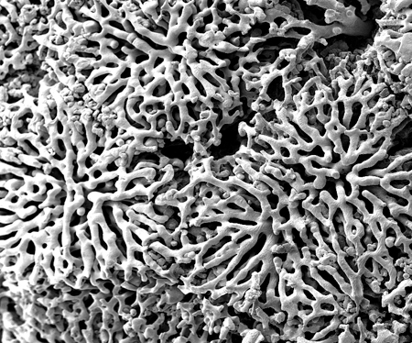
Hepatic zonation of Glucose Metabolism
Matthias König
Berlin, 2013-03-11

Slide 2
Liver Architecture On a Tissue-scale

Slide 3
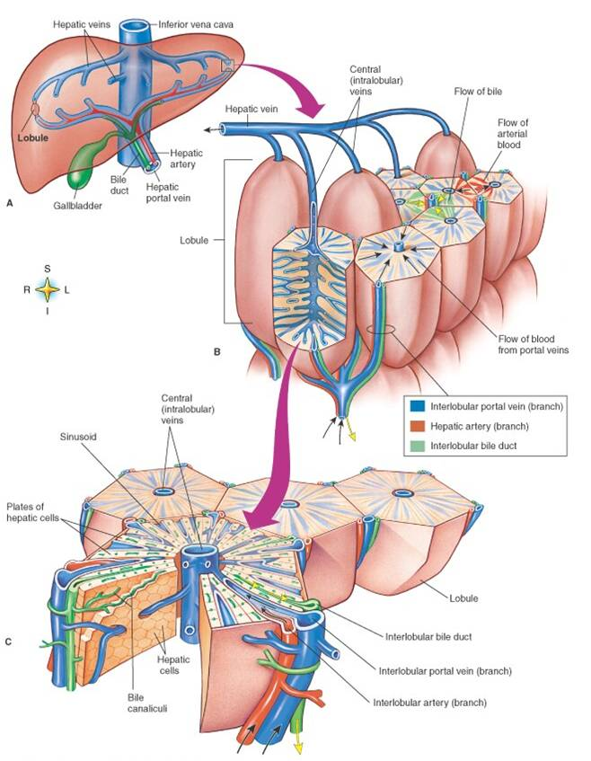
Liver Lobule
liver structured in identical subunits liver lobule
dual blood supply
80% poorly oxygenated venous blood via portal vein
20% well oxygenated via hepatic artery
blood flows via sinusoids towards central vene
pp → pv

Slide 4
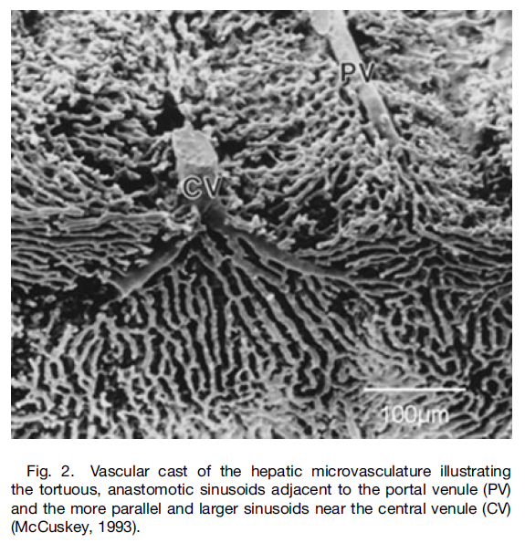
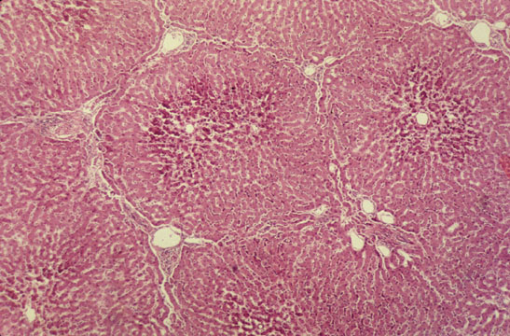

Slide 5
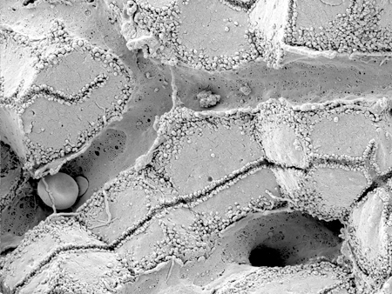
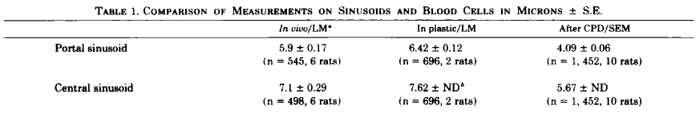
Sinusoid
Scanning electron micrograph showing fenestrated sinusoids and hepatocytes in a mouse liver.
http://www.easloffice.eu/jhep/contest/website/see_photos.html
principal vessels for exchange between blood and hepatocytes
~ 6-8µm diameter
periportal sinusoids are narrower and more tortuous than the wider and straighter central ones
Sinusoid network is heterogeneous
near portal vene arranged as interconnecting polygonal networks
farther away from portal vein organized as parallel vessels terminating in the central vein
short intersinusoidal sinusoids connect adjacent parallel sinusoids
Scanning electron microscope observations on the structure of portal veins, sinusoids and central veins in rat liver. Wisse, E.; De Zanger, R. B.; Jacobs, R. & McCuskey, R. S.; Scan Electron Microsc, 1983, 1441-1452
The liver sieve: considerations concerning the structure and function of endothelial fenestrae, the sinusoidal wall and the space of Disse. Wisse, E.; De Zanger, R. B.; Charels, K.; Van Der Smissen, P. & McCuskey, R. S. Hepatology, 1985, 5, 683-692

Slide 6
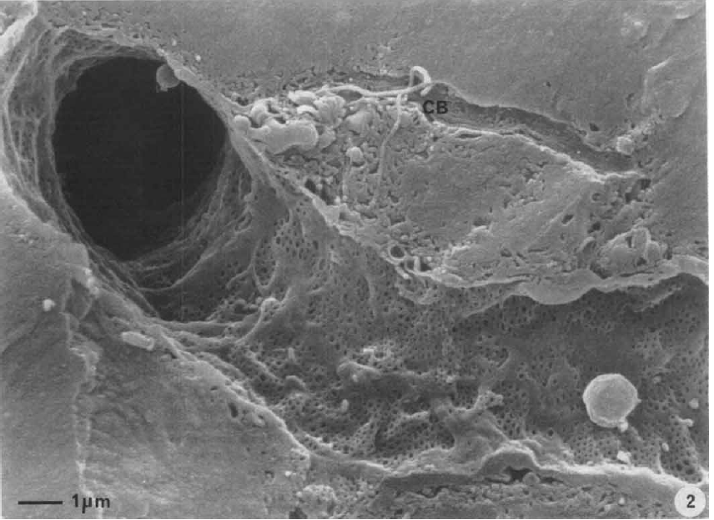
Endothelial Fenestrae
liver sinusoids unique capillaries
open pores (fenestrae) in sinusoidal wall
lack basal membrane underneath endothelium
fenestrae act as sieving barrier between blood and heptocytes
morphological & physiological evidance that fenestrae act as a dynamic filter
important role in lipid metabolism (namely chylomycrons)
Liver sinusoidal endothelial cells (LSEC) constitute sinusoidal wall
numerous endocytotic vesicles
effective uptake of a wide variety of substances from blood via receptor-mediated endocytosis (Braet, 2004)
transcytosis transport across the endothelium to surrounding tissue
scavenger system
Contribution of high-resolution correlative imaging techniques in the study of the liver sieve in three-dimensions. Braet, F. et al; Microsc Res Tech, 2007, 70, 230-242
Structural and functional aspects of liver sinusoidal endothelial cell fenestrae: a review. Comp Hepatol, Braet, F. & Wisse, E., 2002, 1, 1
The liver sieve: considerations concerning the structure and function of endothelial fenestrae, the sinusoidal wall and the space of Disse. Wisse, E.; De Zanger, R. B.; Charels, K.; Van Der Smissen, P. & McCuskey, R. S. Hepatology, 1985, 5, 683-692

Slide 7
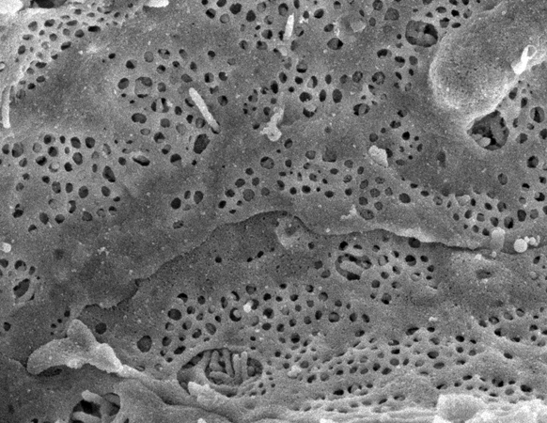
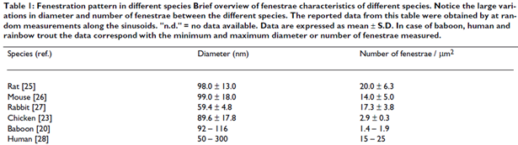
Fenestrae
Scanning electron micrograph of hepatocyte microvilli protruding through the sinusoidal endothelial cell fenestrations.
diameter ~50-200nm
ultrastructure same across species
groups of fenestrae arranged in so called sieve plates
differences periportal & perivenious
diameter decreases (110.7 to 104.8nm)
frequency increases (9 to 13 per µm²)
increased porosity from pp to pv from 6 to 8%
number and diameter may vary between individuals & within single indiviuum under various physiological and pharmacological circumstances

Slide 8
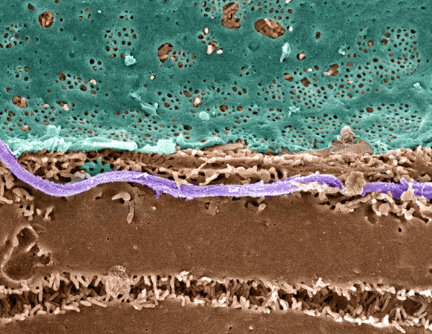
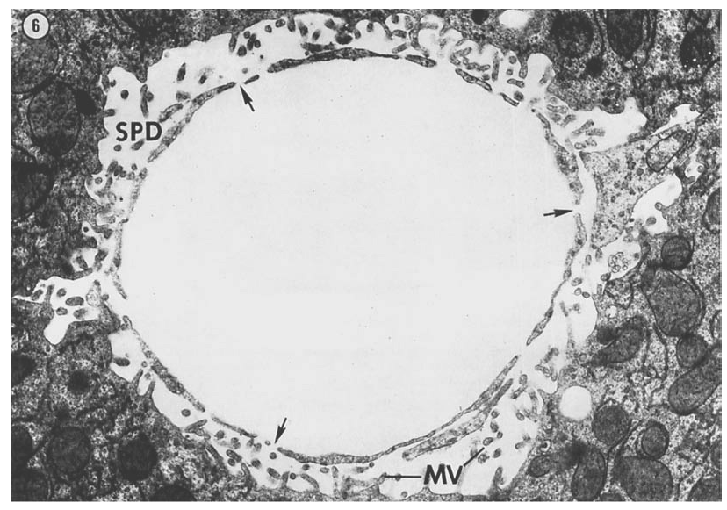
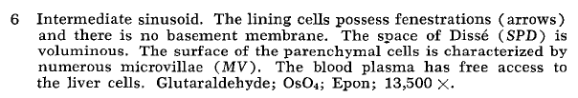
Space of Dissé
Pseudo-colored Scanning EM of an hepatic plate, accentuating the fenstrated sinuoidal endothelium (blue), hepatocyte (brown) and a collagen fibril (lavender).
Hepatocytes surface enlarged via microvilli.
The fine structure of rat liver sinusoids, space of Dissé and associated tissue space. Burkel, W. E. & Low, F. N.; Am J Anat, 1966, 118, 769-783
http://www.easloffice.eu/jhep/contest/website/see_photos.html

Slide 9
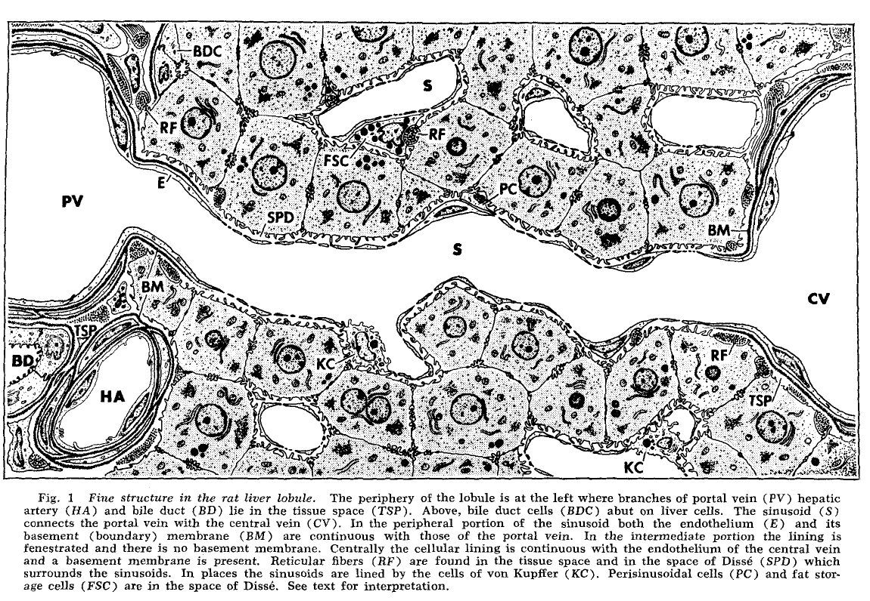
Sinusoid Ultrastructure
fenestraetion & absence of basement membranes provide direct access of blood plasma to hepatocytes
The fine structure of rat liver sinusoids, space of Dissé and associated tissue space. Burkel, W. E. & Low, F. N; Am J Anat, 1966, 118, 769-783

Slide 10
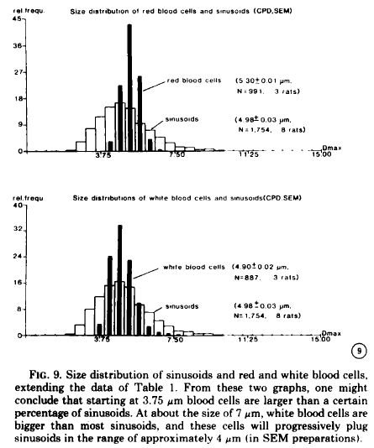
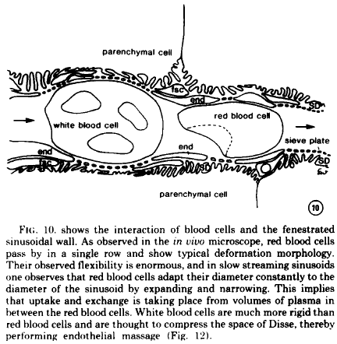
Tight Sinusoids
The liver sieve: considerations concerning the structure and function of endothelial fenestrae, the sinusoidal wall and the space of Disse. Wisse, E. et al; Hepatology, 1985, 5, 683-692

Slide 11
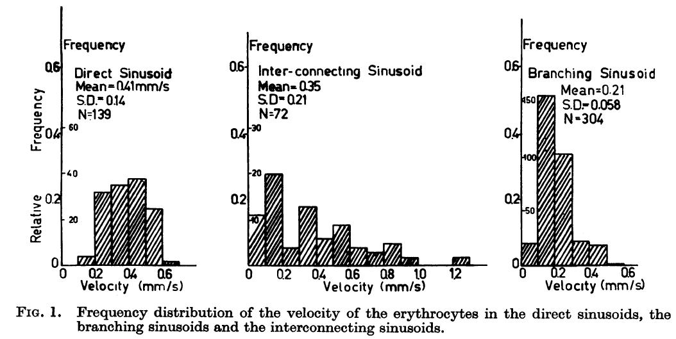
Blood Flow
The terminal hepatic microcirculation in the rat. Koo, A.; Liang, I. Y. & Cheng, K. K.; Q J Exp Physiol Cogn Med Sci, 1975, 60, 261-266
Intermittence of blood flow in liver sinusoids, studied by high-resolution in vivo microscopy. MacPhee, P. J.; Schmidt, E. E. & Groom, A. C.; 1995, 269, G692-G698

Slide 12
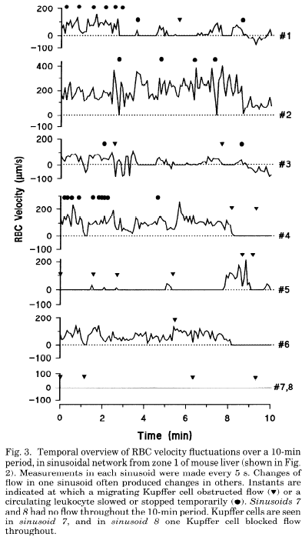
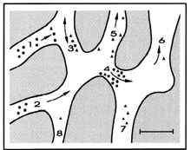
Blood Flow
The terminal hepatic microcirculation in the rat. Koo, A.; Liang, I. Y. & Cheng, K. K.; Q J Exp Physiol Cogn Med Sci, 1975, 60, 261-266
Intermittence of blood flow in liver sinusoids, studied by high-resolution in vivo microscopy. MacPhee, P. J.; Schmidt, E. E. & Groom, A. C.; 1995, 269, G692-G698

Slide 13
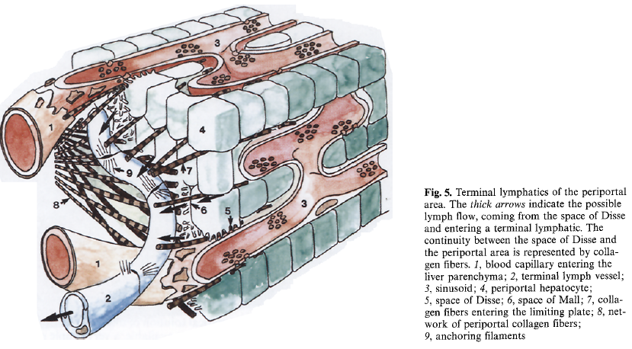
Lymph
substantial amount of hepatic lymph is generated in space of Dissé
space of Dissé is continuos with the tissue space at both ends of the sinusoid !
high protein content of hepatic lymph
lymphatic vessels originate as blind-ending capillaries in the connective tissue spaces (portal tracts) associated with the portal veins and hepatic arteries
fluid contained in these lymphatics flows toward the hepatic hilus and eventually into the cisternae chyli
Lymph circulation in the liver. Ohtani, O. & Ohtani, Y.; Anat Rec; 2008, 291, 643-652
The lymphatics of the liver. Trutmann, M. & Sasse, D. ; Anat Embryol (Berl), 1994, 190, 201-209

Slide 14
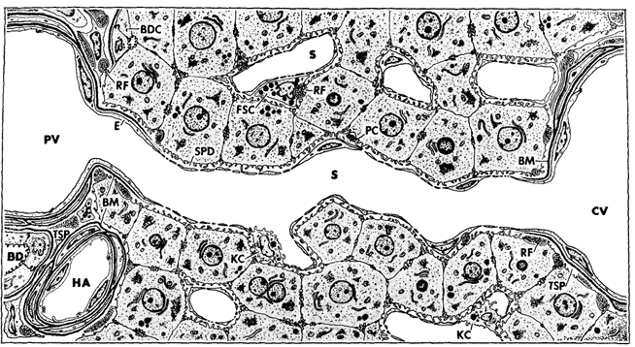
Metabolic zonation of Glucose metabolism

Slide 15
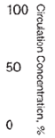
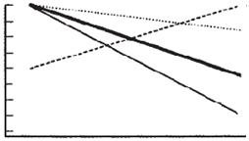
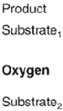
Zonated Metabolites
production/utilization by hepatocytes along sinusoid
depending on hepatic metabolism & exchange
glucose & lactate between 10-50% increase/decrease
O2 ~50% decline with strong longterm & shortterm effects of O2 on glucose metabolism
Role of oxygen in the zonation of carbohydrate metabolism and gene expression in liver. Jungermann, K. & Kietzmann, T. Kidney Int, 1997, 51, 402-412
Long-term effects of physiological oxygen concentrations on glycolysis and gluconeogenesis in hepatocyte cultures. Wölfle, D. & Jungermann, K.; Eur J Biochem, 1985, 151, 299-303

Slide 16
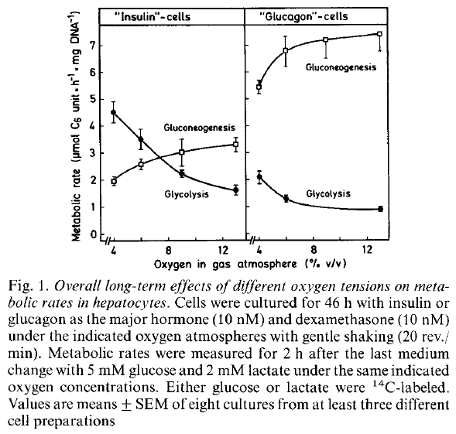
Zonated Metabolites
production/utilization by hepatocytes along sinusoid
depending on hepatic metabolism & exchange
glucose & lactate between 10-50% increase/decrease
O2 ~50% decline with strong longterm & shortterm effects of O2 on glucose metabolism
Role of oxygen in the zonation of carbohydrate metabolism and gene expression in liver. Jungermann, K. & Kietzmann, T. Kidney Int, 1997, 51, 402-412
Long-term effects of physiological oxygen concentrations on glycolysis and gluconeogenesis in hepatocyte cultures. Wölfle, D. & Jungermann, K.; Eur J Biochem, 1985, 151, 299-303

Slide 17
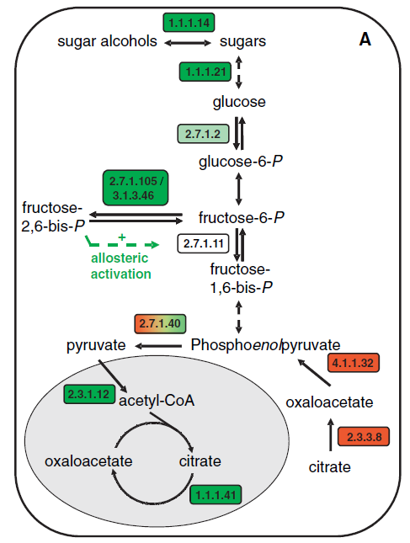
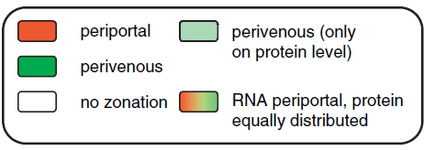
Zonated Gene Expression
Differential gene expression in periportal and perivenous mouse hepatocytes. Braeuning, A. et al.; , 2006, 273, 5051-5061

Slide 18
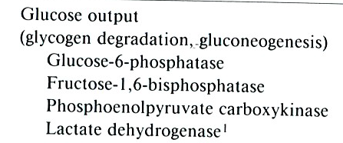
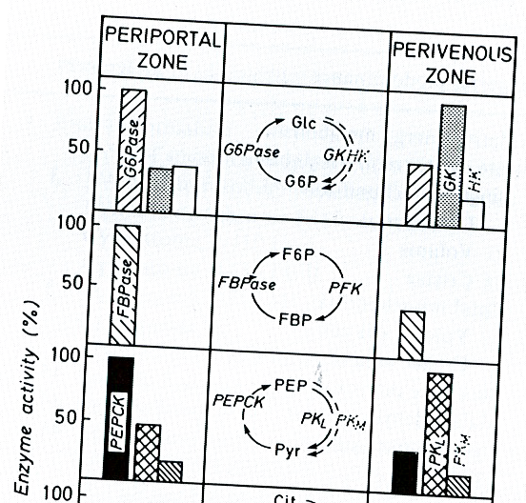
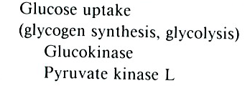
Zonated Protein Levels
Functional heterogeneity of periportal and perivenous hepatocytes. Jungermann, K.; Enzyme, 1986, 35, 161-180

Slide 19
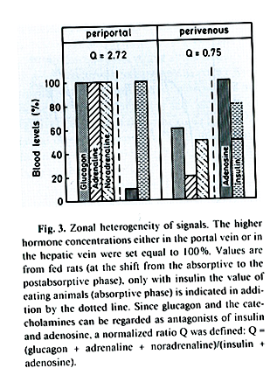
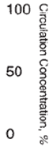
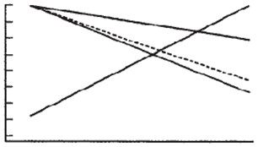
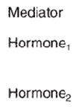
ZonatED Signalling
Hormonal gradients
liver main role in clearance of hormones
insulin (85-50% fasting, postprandial)
glucagon (~50%) & epinephrine
but also producer of hormones
large adenosine gradient
changing ratio (glucagon+epinephrine)/insulin
Hepatocyte heterogeneity in the metabolism of carbohydrates. Jungermann, K. & Thurman, R. G.; Enzyme, 1992, 46, 33-58

Slide 20
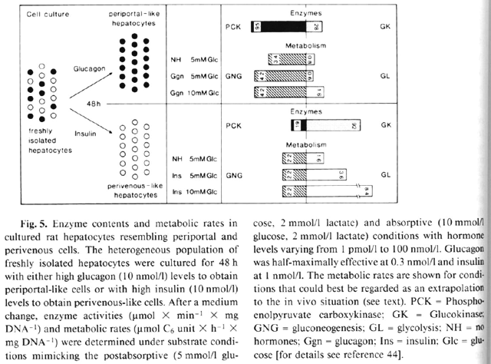
Induction of pp/PV via Insulin & Glucagon
Hepatocyte heterogeneity in the metabolism of carbohydrates. Jungermann, K. & Thurman, R. G.; Enzyme, 1992, 46, 33-58

Slide 21
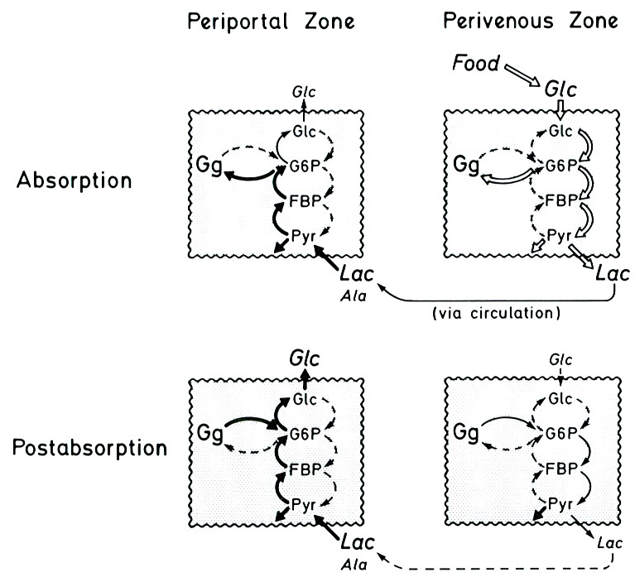
Zonated Glucose Metabolism
Functional heterogeneity of periportal and perivenous hepatocytes. Jungermann, K.; Enzyme, 1986, 35, 161-180

Slide 22
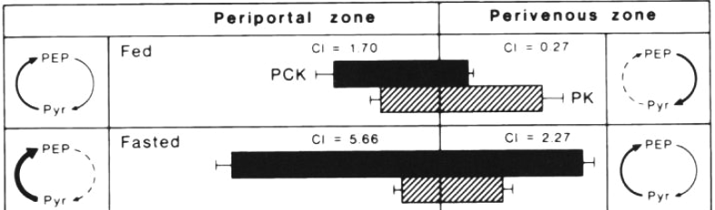
Dynamic Zonation
Adaptations of zonation depending on physiological state
fed -> fast transition associated with decreasing insulin & increasing glucagon
hormone/oxygen dependent expression
adapting enzyme activities via hormone gradients on longer time scale (expresson signal integrator over the last hours)
in addition to fast regulation via interconvertible enzymes
Hepatocyte heterogeneity in the metabolism of carbohydrates. Jungermann, K. & Thurman, R. G.; Enzyme, 1992, 46, 33-58

